Slide 1

Academic Programmes
Academic Framework
Quality Assurance and Academic Programmes Manager
Dr Zainab Alkhatib
September 2025

Slide 2

The Open University
Accrediting & Awarding Body
OU Regulations
OU Handbook
Academic Framework
External Examiner
Academic Reviewer
OU Manager
Quality Assurance Manager
Exam Board
Student Transcripts
Graduation Certificates

Slide 3
The Open University
Accrediting & Awarding Body
Annual Review- Once a year
Admin Audit- Every 5 years
Institutional Review- Every 5 years
Programme Revalidation- Every 5 years

Slide 4
Faculty Board
Exam Board
Dean
Programme Leads
Faculty Members
Registrar
Student Representative
Quality Assurance Manager
External Examiner
Academic Reviewer
OU Manager
Quality Assurance Manager

Slide 5
Exam Board
Faculty Board
  Meet Monthly
  Approve all decisions relevant to all Academic Programmes
  Discuss Students matters and feedback in relation to Academic Programmes
  Approve Student Results
  Main Exam Board: End of July
  Student Resit opportunity during August
  Resit Exam Board: Beginning of September

Slide 6
Academic Framework
Assessment Policy
Marking and Moderation Policy
Student Guidance and Support
Student Feedback
Student Complaint
Student Discipline
Academic Misconduct Policy
Academic Appeal Policy
Period of Registration
Attendance Policy
Extenuating circumstances
Disability and Equal Opportunity
Equality and Diversity Policy
Safeguarding Policy

Slide 7
Academic Framework
Student Guidance and Support
Academic Supervisor
General Support

Slide 8
Academic Framework
Disability and Equal Opportunity
Equality and Diversity Policy
If you need any support, email: studentservices@cambridgemuslimcollege.ac.uk

Slide 9
Academic Framework
Student Complaint
Student Discipline
Emails: studentservices@cambridgemuslimcollege.ac.uk
Admin@cambridgemuslimcollege.ac.uk

Slide 10
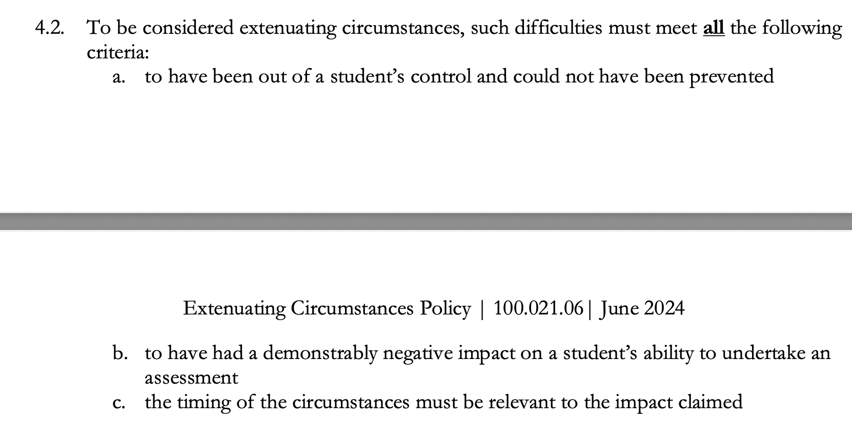
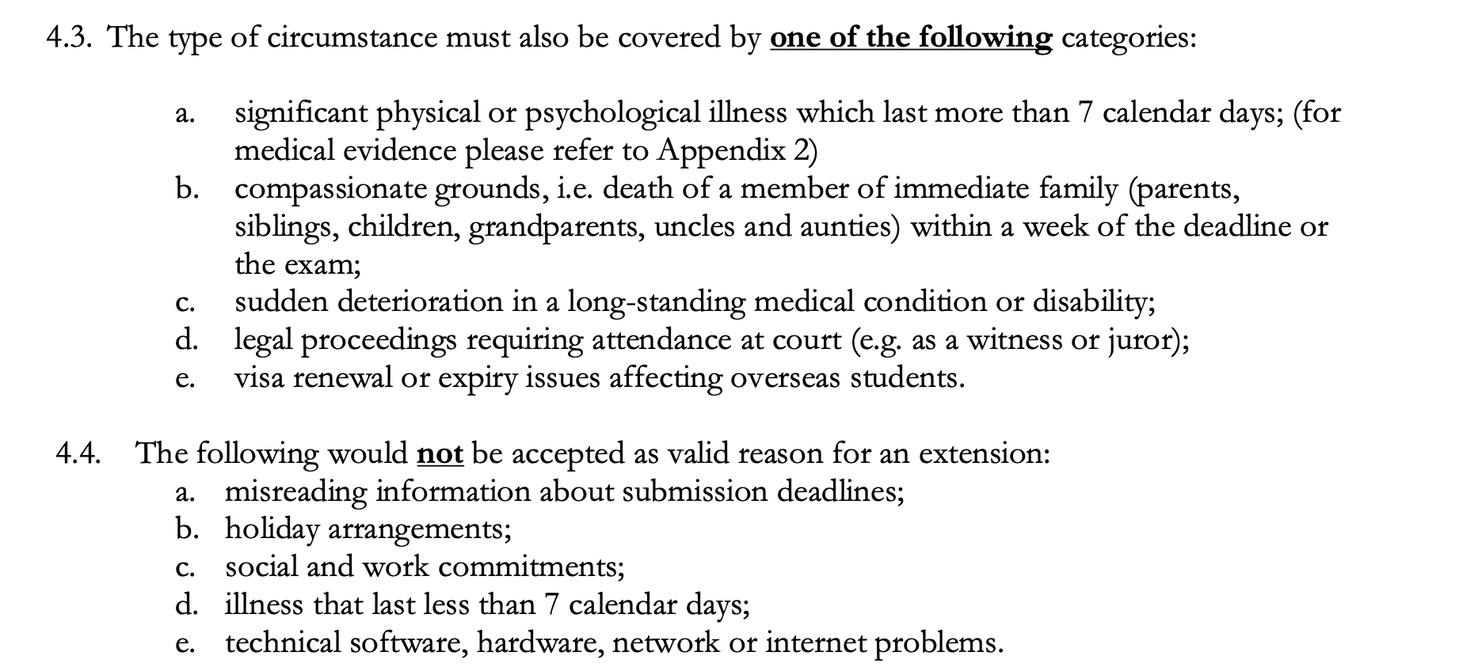
Extenuating Circumstances

Slide 11
Programme Review
  Student Feedback- Academic Matters: December, March & June
  Student Representative: Attend Faculty Board meetings
  Module Specifications Review: March every year
  Programme Internal Review (PIR): July every year
ZK

Slide 12
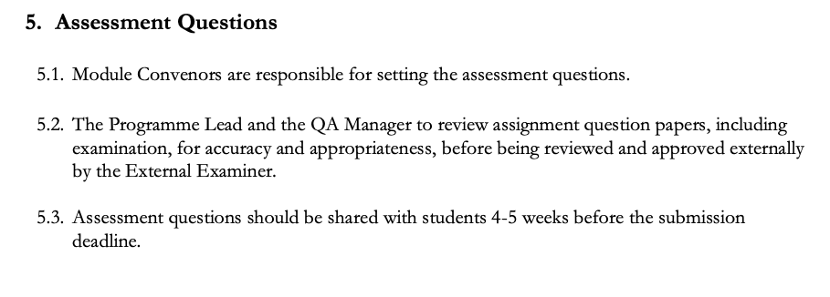
Assessment Questions

Slide 13
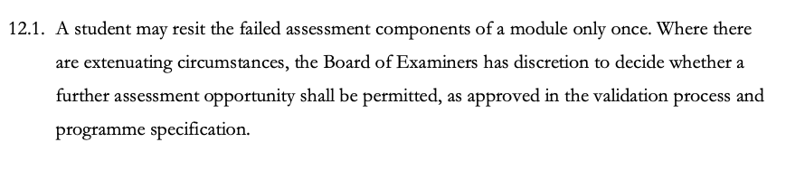

Assessment Resit Questions
During August

Slide 14
Assessment Questions
Assessment questions should be approved by the External Examiner before sharing them with students

Slide 15
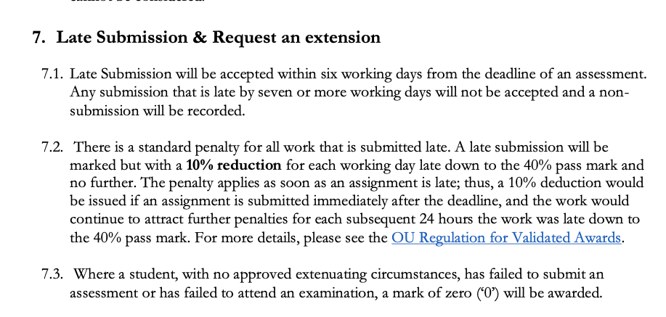
Assessment

Slide 16
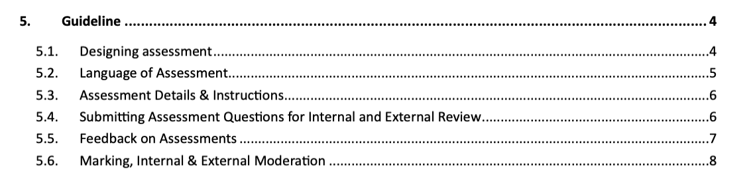
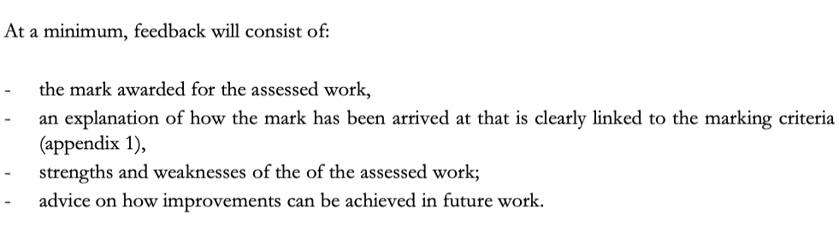
Assessment Guideline
Assessment Language is English

Slide 17
Marking and Moderation
Within two weeks of submission deadline
Follow the “Marking Criteria”

Slide 18
Marking and Moderation
First Marking- Lecturers
Internal Moderation Second Marking by Module Convenor
Provisional marks
External Moderation External Examiner
2 Exam boards
End of July
Beginning of September
Late submission penalty (Admins)
“Moderation Sheet”
What should be done to improve the assignment or Students’ performance.

Slide 19
Academic Misconduct_ Use of AI
Your assignments must be your own work, from the first draft to the final submitted assignment.
You must not use another individual or automated software tool to do your work. This could include:

Slide 20
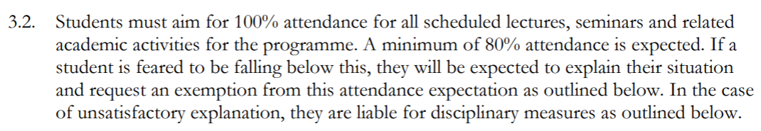
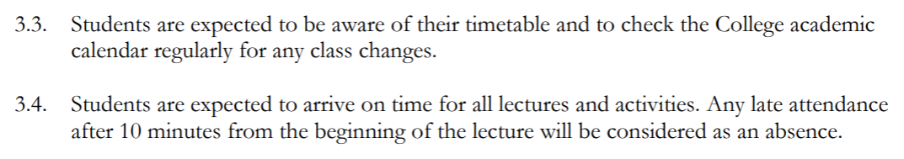
Attendance Policy

Slide 21
Assessments (Exams settings)
Classical Arabic Programme
Midterm Quiz
End of Term Exam
End of Year Exam
Week 7 of term 1 and term 2 (after reading week)
Not credited (does not count toward final grade)
Only for Nahw and Sarf modules (speaking & listening?)
At the end of term 1 and term 2
Students must get minimum 50% with one opportunity to resit.
If they do not pass the assessment, they cannot continue onto the course
Arabic Literature & Classical Islamic Texts modules have a translation assessment in term 3.
All core modules

Slide 22
Classical Arabic Programme
Module | Term | Assessment | Deadline
Sarf (Arabic Morphology) | All 3 terms | Two end of term (1 & 2) oral exams 25% each End of year exam 50% | Week 11 of Terms 1 & 2 Exam Week
Naḥw (Arabic Syntax) | All 3 terms | Two end of term (1 & 2) exams 25% each End of Year exam 50% | Week 11 of Terms 1 & 2 Exam Week
Arabic literature | All 3 terms | Term 2 week 11 translation exam 50% End of year exam 50% | Term 2 week 11 Exam week
Classical Islamic Texts | Term 2 | Translation exam (Exam) 50% End of year written exam 50% | Term 3, Week 5 Exam week

Slide 23
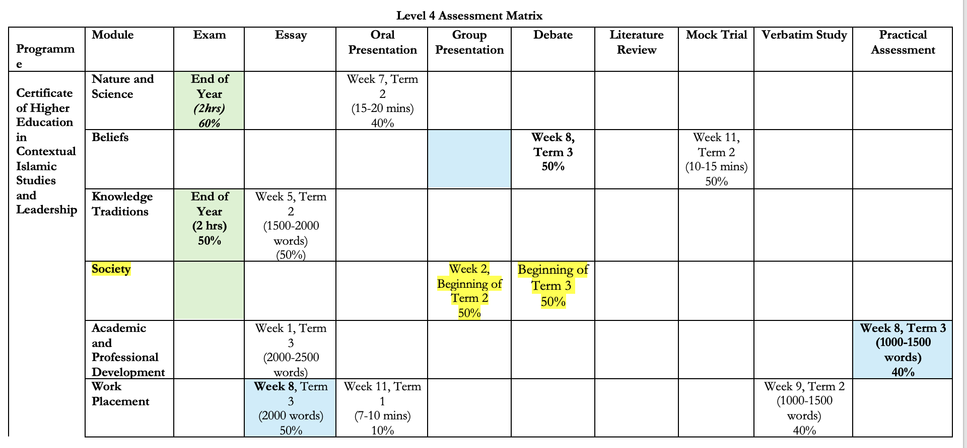
CertHE in CISL Programme

Slide 24
Assessment
PGCertHE in I&P Programme
Programme | Module | Essay | Oral Presentation | Reflections
PGCert HE in in Islam and Psychology | Foundations of Islamic Psychology | Week 11 (3500-4000) 70% | Week 7 Week 8 (10 mins each) 30%
 | Transformations of Worldviews | Week 11 (4000) 70% | Different deadlines (10 mins each) 30%
 | Integrations of Application in Community |  | Group Presentation Week 11 30 minutes 50% | Reflection 1 (250 words) Week 4 Reflection 2 Week 7 Reflection 3 Week 10 (30%)

Slide 25
Assessments (Exams settings)
Classical Arabic Programme
Credited Assessment
Specific deadline-Module Spec and Syllabus
50% is the passing mark for each main modules.
Extension to follow the Extenuating Circumstances policy through admin team
When failing, there is a resit option
Mid-Term Quiz and Homework
Specific deadline- Syllabus
Extension to be given by lecturers for couple of days only
When failing, lecturers to follow up with student and put a plan for support

Slide 26
Resit Opportunities
Classical Arabic Programme
  Student should achieve 50% for the credited assignments/ exams of the following modules:
  1. Nahw
  2. Sarf
  Allow one resit chance after a month of the original date.
  Resit opportunity/ repeat is given to students one time only.
  Failing the resit means failing the course.
ZK

Slide 27
Class code of conduct
Punctuality Policy
Students are expected to arrive on time for all lectures. Any anticipated lateness must be supported by a valid excuse that has been pre-approved by Student Services. Students who arrive more than 15 minutes late without prior clearance will not be permitted to enter the lecture.
(No)Technology Policy
All mobile phones must be switched off before the lecture begins. During registration, the lecturer may ask students to raise their hands to confirm compliance. The use of laptops in class is not permitted, including for note-taking. Exceptions will only be made for specific in-class exercises (e.g., consulting classical dictionaries). Physical copies of Hans–Wehr are permitted in class. Students with documented learning difficulties may request accommodations through Student Services, and exceptions will be granted in coordination with their recommendations.

Slide 28
Moodle
Student Portal
Virtual Learning Environment (VLE)
Module Specifications
Syllabus
Reading Materials
Slides (Optional)
Forums/Discussions
Credential/ Summative Assessment & Homework
Bmc elearning wisenet
https://cambridgemuslimcollege.wisenet.co/
Academic Framework/ Policies
Attendance Policy
Assessment Policy
Marking and Moderation Policy
Student Handbook
Forms
https://cambridgemuslimcollege.sharepoint.com/sites/Studentportal

Slide 29
General information
  Moodle, Assessment and Exam:
  Academic Amin: Admin@cambridgemuslimcollege.ac.uk
  Timetable, classes, IT issues and others:
  Student Services: studentservices@cambridgemuslimcollege.ac.uk
  IT issues:
  HBP on 01724 400304 or email: it@thehbpgroup.co.uk
ZK

Slide 30
Academic Department Structure
Faculty Board
Academic Lead+ QA Manager
Programme Lead
Module Convenor
Lecturers
Registrar
Student Services
Student Experience Feedback is collected
Student Feedback-Modules and lectures is collected

Slide 31
Academic Programmes
BA (Hons) in Islamic Studies (Level 6)
Programme Lead: Dr Belal Alabbas
September 2025

Slide 32
Programme Objectives
to develop a balanced and detailed understanding of classical disciplines in the Islamic tradition, the contexts in which they have developed and the ways in which they deal with contemporary issues and challenges.
to provide the student with the opportunity to acquire critical understanding of key theories, principles and texts within the Islamic tradition and its classical disciplines.
to develop a detailed understanding of classical Arabic and equip students with the ability to read, understand and interpret classical Islamic texts.
to provide a general understanding of key aspects of relevant contemporary intellectual disciplines which intersect with the study of religion and its application to contemporary society.
to develop an awareness of the history and contemporary state of British society, and in particular, the Muslim communities in Britain, and how these relate to global trends.
to develop and inculcate in students an independence of judgment, critical thinking and the ability to communicate effectively in ways that are relevant to the field of scholarship and the wider professional world.
31 October 2020
Dr Abdallah Rothman

Slide 33
Programme Learning Outcomes
knowledge and systematic, critical understanding of the core disciplines of the Islamic scholarly tradition, including awareness of the interrelationship of various disciplines, and key approaches to their contemporary application in complex modern, global contexts.
knowledge and critical understanding of the linguistic and stylistic features of key texts, and classical Arabic sciences.
knowledge and critical understanding of contemporary intellectual disciplines that are relevant to the study of the Islamic scholarly tradition, including key ideas, figures, and historical development.
the ability to develop and sustain a critical and original logical argument that is supported by significant evidence using well-established frameworks and methods.
the ability to answer questions of varying complexity by collecting and synthesizing information from relevant sources using well-established frameworks and methods, reflecting independent and original judgment.
Dr Abdallah Rothman

Slide 34
Programme Structure - LEVEL 4
Compulsory Modules | Credit points
Arabic 1 | 20
Islamic Theology 1 | 20
Islamic Law 1 | 20
Qur’anic Studies 1 | 15
Hadith Studies 1 | 15
Classical Logic 1 | 10
Islamic History | 10
The Social Sciences | 10
Programme Structure - LEVEL 5
Compulsory Modules | Credit points
Arabic 2 | 15
Islamic Theology 2 | 20
Islamic Law 2 | 20
Qur’anic Studies 2 | 15
Hadith Studies 2 | 15
Classical Logic (2) & the Art of Dialectic | 10
Spiritual Discipline & Ethics | 10
The Western Philosophical Tradition | 10
Religion & Religions | 5
Programme Structure - LEVEL 6
Compulsory Modules | Credit points
Arabic 3 | 10
Islamic Theology 3 | 20
Islamic Law 3 | 20
Qur’anic Studies 3 | 15
Hadith Studies 3 | 15
Islamic Legal Theory | 10
Religion in Modern Society | 10
Dissertation/Independent Research Project | 20
31 October 2020
Dr Abdallah Rothman

Slide 35
Programme Structure - LEVEL 5
Compulsory Modules | Credit points
Arabic 2 | 15
Islamic Theology 2 | 20
Islamic Law 2 | 20
Qur’anic Studies 2 | 15
Hadith Studies 2 | 15
Classical Logic (2) & the Art of Dialectic | 10
Spiritual Discipline & Ethics | 10
The Western Philosophical Tradition | 10
Religion & Religions | 5
31 October 2020
Dr Abdallah Rothman

Slide 36
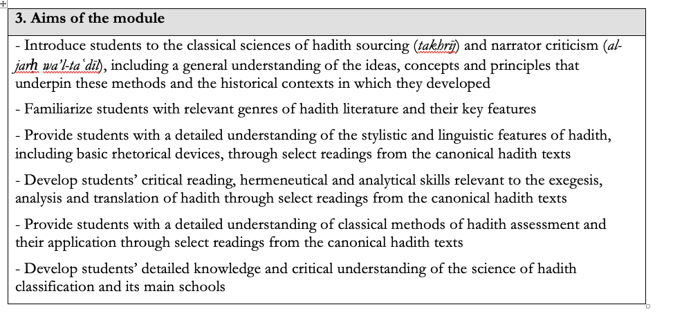
Hadith Studies 2 Module
31 October 2020
Dr Abdallah Rothman

Slide 37
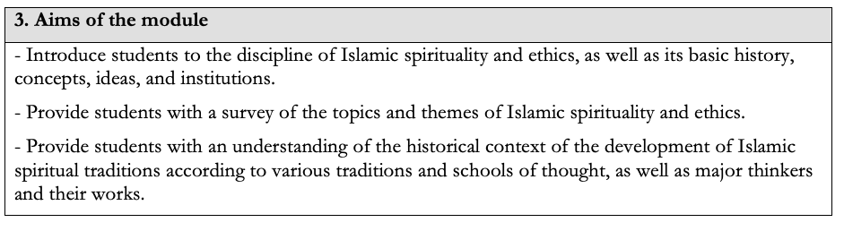
Spiritual Discipline & Ethics Module
31 October 2020
Dr Abdallah Rothman

Slide 38
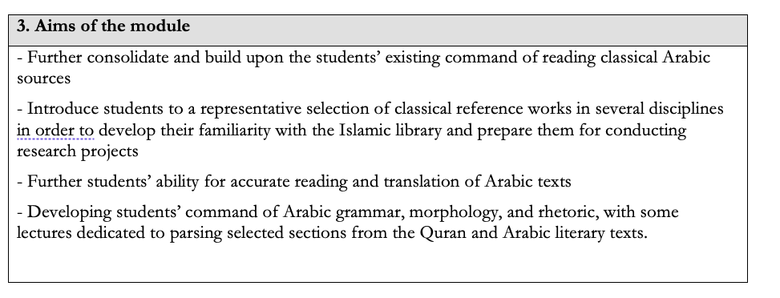
Arabic 2 Module
31 October 2020
Dr Abdallah Rothman

Slide 39
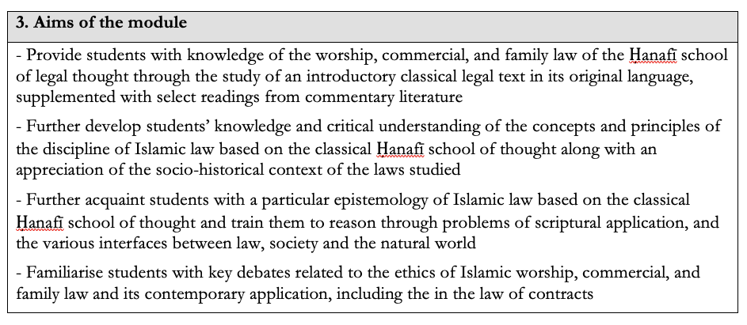
Islamic Law 2 Module
31 October 2020
Dr Abdallah Rothman

Slide 40
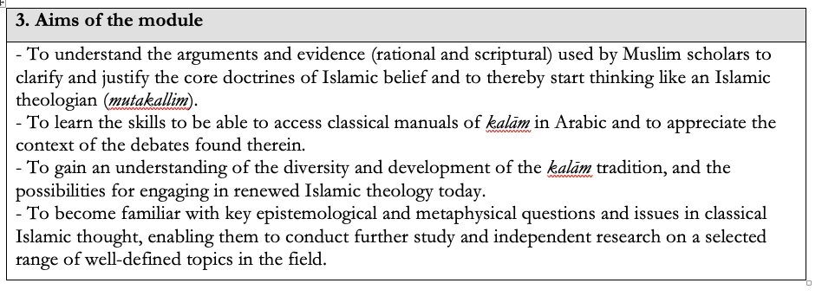
Islamic Theology 2 Module
31 October 2020
Dr Abdallah Rothman

Slide 41
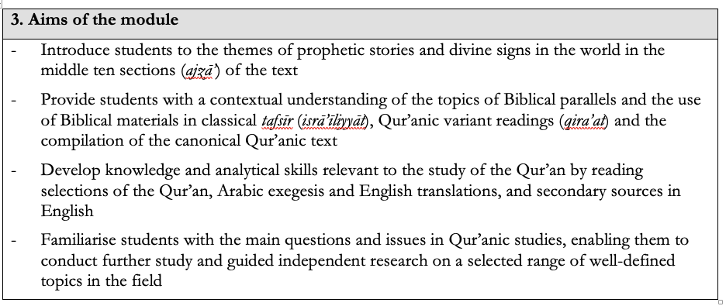
Quranic Studies 2 Module
31 October 2020
Dr Abdallah Rothman

Slide 42
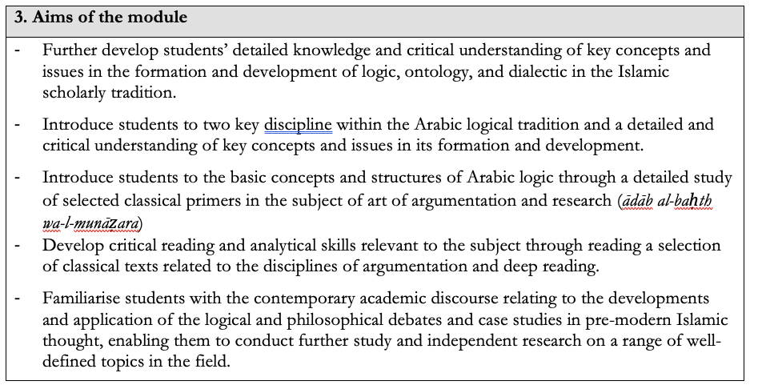
Classical Logic 2 Module
31 October 2020
Dr Abdallah Rothman

Slide 43
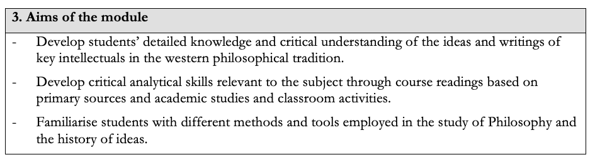
Western Philosophical Tradition Module
31 October 2020
Dr Abdallah Rothman

Slide 44
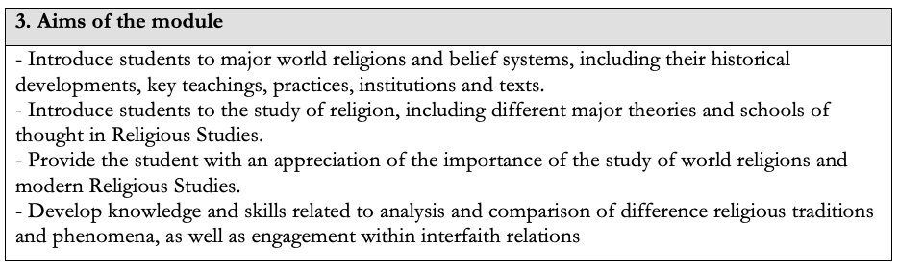
Religion & Religions Module
31 October 2020
Dr Abdallah Rothman

Slide 45
Academic Programmes
Cert HE in Contextual Islamic Studies and Leadership (Level 4)
Programme Lead: Dr Salman Younas
September 2025

Slide 46
Programme Objectives
to provide students with an understanding of our past and how the modern world was shaped through the study of relevant contemporary intellectual and scientific disciplines.
to enable students to understand and engage with contemporary debates about the role of religion in general, and Islam in particular, in modern society.
to develop an awareness of the history and contemporary state of British society, and in particular, the Muslim communities in Britain, and how these relate to local and global trends.
to equip students with (a) academic skills that will enable them to pursue further studies and aid them in the articulation and application of the Islamic tradition to contemporary issues and challenges and (b) practical and professional skills to make them more effective leaders of Muslim institutions and to enhance their career prospects in all fields.
to provide students with an awareness of various approaches to pastoral care, including hands on experience, to be compassionate and reliable spiritual and pastoral advisors to Muslims and others.
31 October 2020
Dr Abdallah Rothman

Slide 47
Programme Learning Outcomes
Foundational knowledge and understanding of the study of science, religion and philosophy, and society in their historical contexts, including key social, cultural, and political developments.
Foundational knowledge and understanding of the historical and contemporary interactions and engagements between Islam and other traditions.
Understanding of the application of the Islamic scholarly tradition to contemporary contexts.
Awareness of where ideas and concepts are open to debate in each field of study.
Foundational knowledge and understanding of key theories and approaches to Pastoral Care and Leadership.
The ability to evaluate arguments, analyse concepts and theories and apply classical Islamic sciences within other intellectual traditions.
31 October 2020
Dr Abdallah Rothman

Slide 48
Programme Structure
Programme Content & Structure – Level 4
Compulsory Modules | Credit points
Nature and Science | 20
Beliefs | 20
Knowledge Traditions | 20
Society | 20
Academic and Professional Development | 20
Work Placement- Addenbrookes Chaplaincy | 20
 | 120 Total Credits (Level 4)
31 October 2020
Dr Abdallah Rothman

Slide 49

Work Placement- Addenbrookes Chaplaincy
A year-long free work placement opportunity from September 2025. The work placement will provide an in-depth training in the field of chaplaincy. The work placement will open opportunities for employment as there is a huge demand for Muslim Chaplains in the health sector, Universities and others.
31 October 2020
Dr Abdallah Rothman

Slide 50
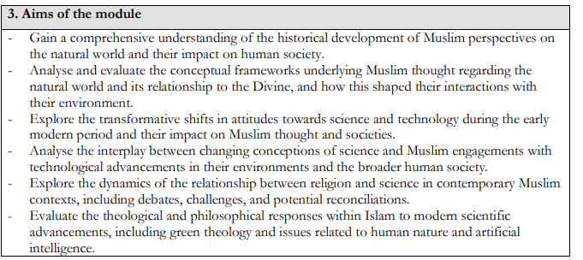
Nature and Science Module
31 October 2020
Dr Abdallah Rothman

Slide 51
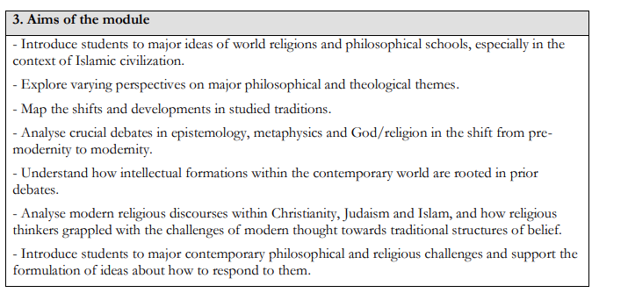
Beliefs Module
31 October 2020
Dr Abdallah Rothman

Slide 52
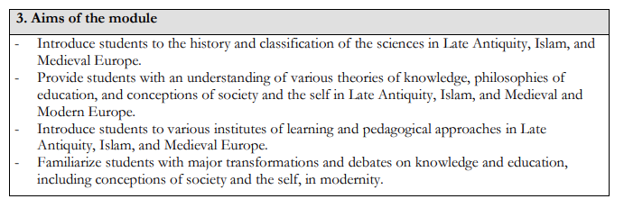
Traditional Knowledge Module
31 October 2020
Dr Abdallah Rothman

Slide 53
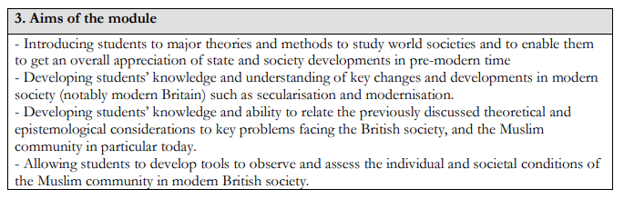
Society Module
31 October 2020
Dr Abdallah Rothman

Slide 54
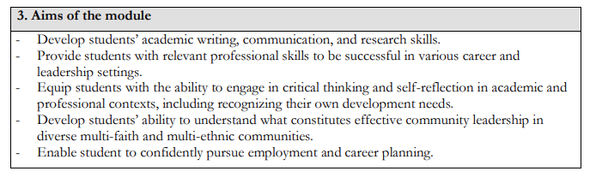
Academic and Professional Skills Module
31 October 2020
Dr Abdallah Rothman

Slide 55
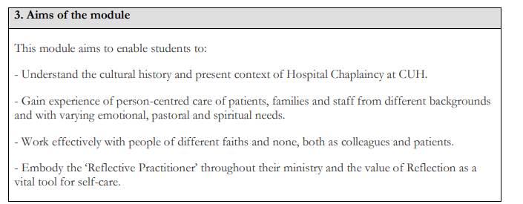
Work placement- Chaplaincy Module
31 October 2020
Dr Abdallah Rothman

Slide 56
Academic Programmes
PGCert HE in Islam and Psychology (Level 7)
Programme Lead: Dr Abdallah Rothman
September 2025

Slide 57
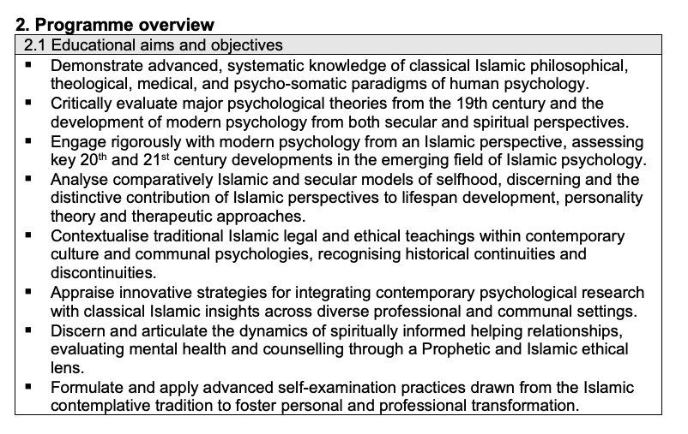
Programme Objectives
Dr Rothman

Slide 58
Programme Structure
Compulsory modules | Credit points | Module Convenor
Module 1 - Foundations of Islamic Psychology | 20 | Dr Najah Nadi
Module 2- Transformations of Worldviews | 20 | Dr Samir Mahmoud
Module 3 - Integrations of Application in Community | 20 | Dr Abdallah Rothman
Dr Rothman

Slide 59
Module Specifications
Foundations of Islamic Psychology
Component A: Historical development of Islamic Psychology
Component B: Theological foundations for the concept of the Soul/Psyche
Component C: Medical and Social Dimensions of Islamic Psychology
Transformations of Worldviews
Component A: Emergence of the Modern Self
Component B: Western Psychologies & Spirituality
Component C: Contemporary Islamic Psychological Movements
Integrations of Application in Community
Component A: Lifespan & Personality
Component B: Socio‐Cultural Contexts
Component C: Psychotherapy & Counselling
Dr Rothman

Slide 60
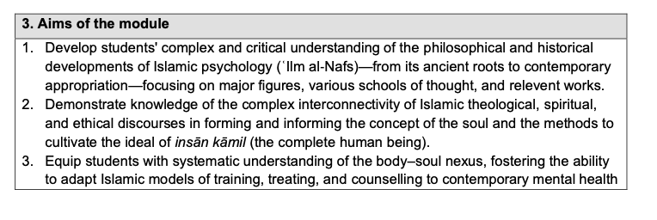
Foundations of Islamic Psychology
Dr Najah Nadi

Slide 61
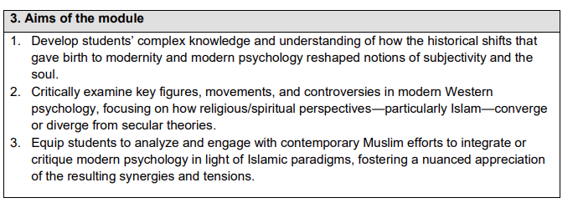
Transformations of Worldviews
Dr Samir Mahmoud

Slide 62
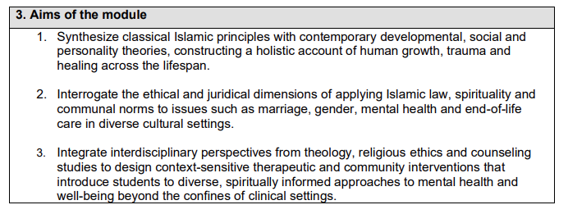
Integrations of Application in Community
Dr Abdallah Rothman

Slide 63
Student Code of Conduct
Always act with the highest moral character as exemplified by the Noble Prophet ﷺ, whether in public or private, online or in-person.
Be straightforward with sincerity, fairness and truthfulness.
Be aware of and have regret for our own faults, rather than finding fault with others.
Seek help and support when needed through the channels provided.
Be helpful at all times, even when not asked.
Be prompt and punctual, whether for lectures, meetings or assignment deadlines.
Observe confidentiality and maintain the good reputation of one another and the CMC.
Maintain a respectful and professional demeanour when interacting with all staff, students and visitors of the college.
Uphold the principle and practice of the sacred inviolability of every person who engages with the CMC, as established by the Noble Prophet ﷺ .
Dr Abdallah Rothman

Slide 64
Academic Programmes
Classical Arabic Programme
Programme Lead: Dr Aaminah Patel
September 2025

Slide 65
Programme Objectives
Essential grammatical and morphological principles of Classical Arabic needed for further Islamic studies.
Applying these principles to simple and complex Classical Arabic sentences, including sentence parsing (iʿrāb) through various foundational texts.
Developing Core Language Proficiency including:
Be able to read the Qur’an and beginner-level Arabic texts with at least 50% comprehension without a dictionary and most of the content with one
  Ability to read beginner-level unvowelled texts with 60% accuracy
  Engage in basic conversations in Classical Arabic
  Compose short paragraphs in Arabic independently
31 October 2020
Dr Abdallah Rothman

Slide 66
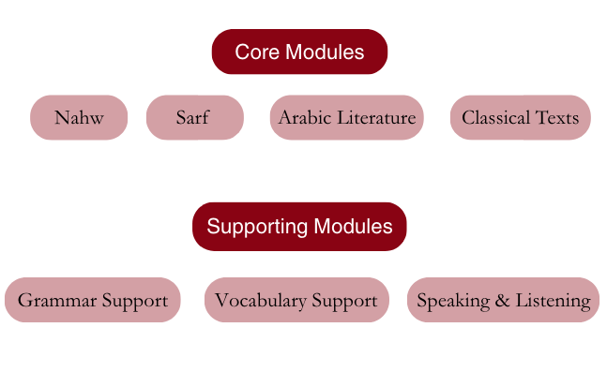
Programme Structure

Slide 67
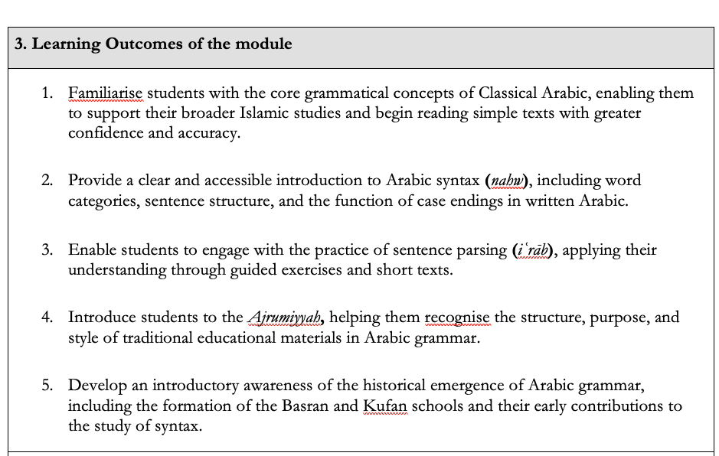
Nahw Module

Slide 68
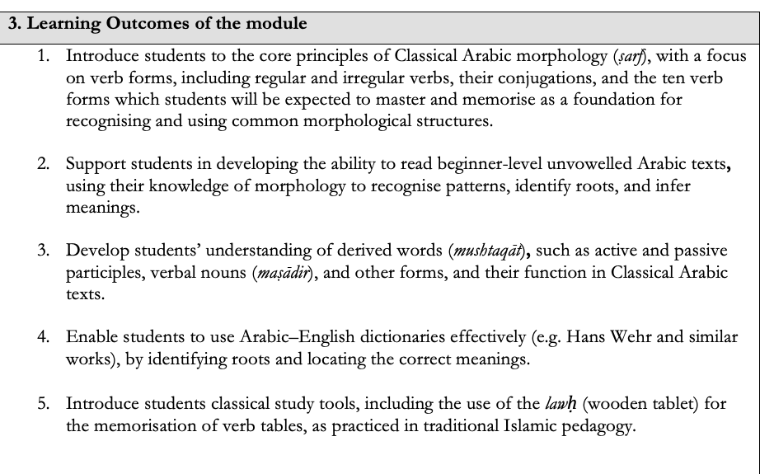
Sarf Module

Slide 69
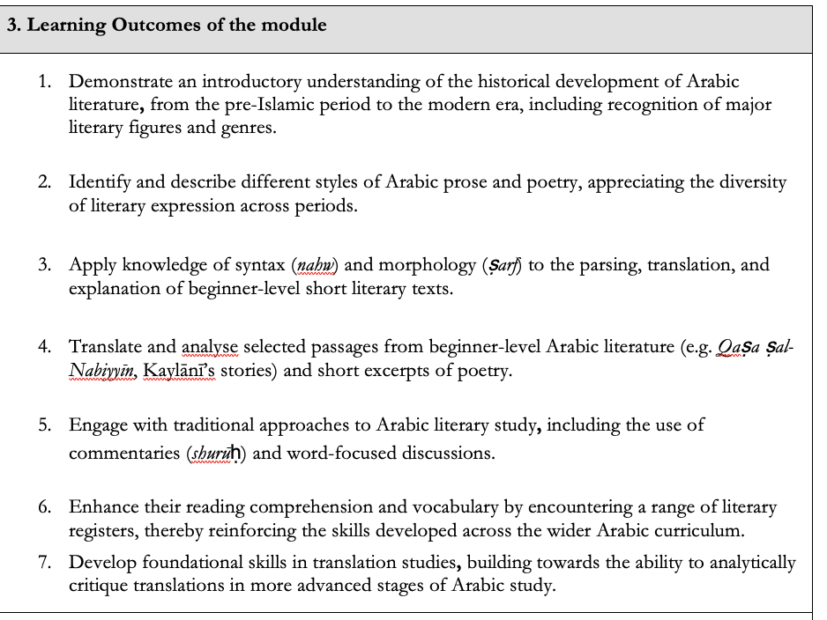
Classical Literature Module

Slide 70
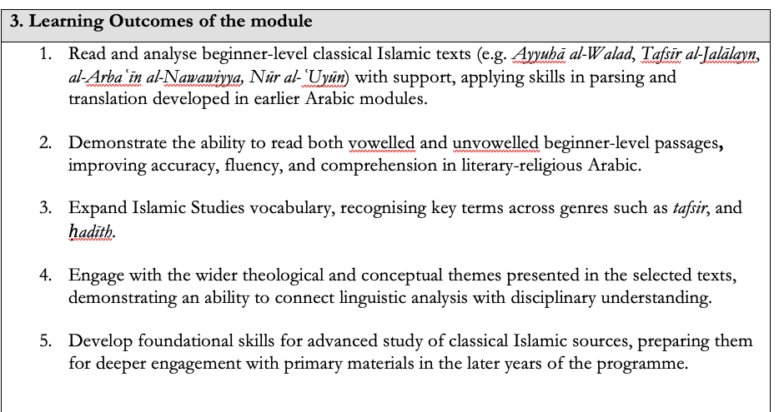
Classical Text Module

Slide 71
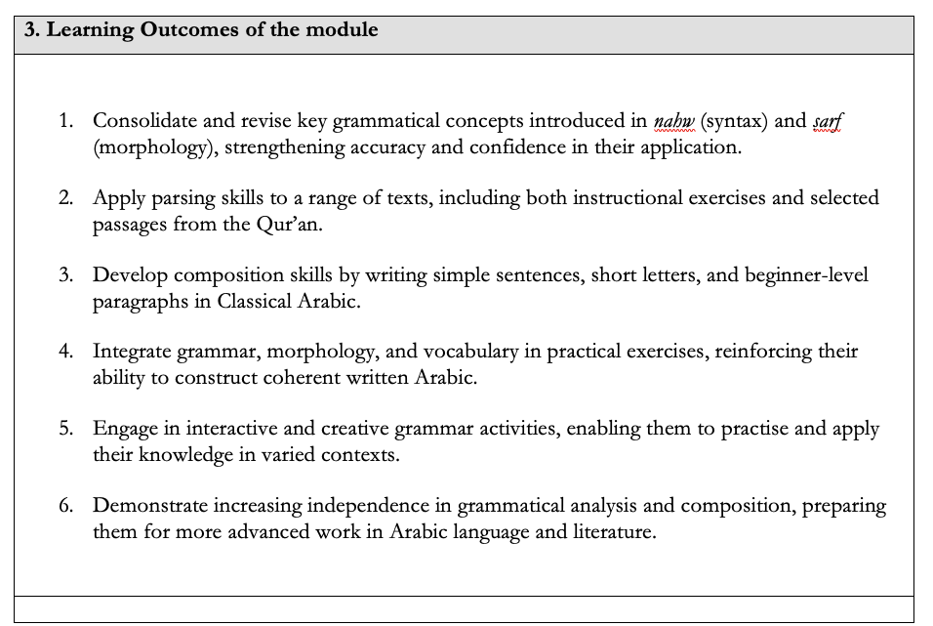
Grammer Support

Slide 72
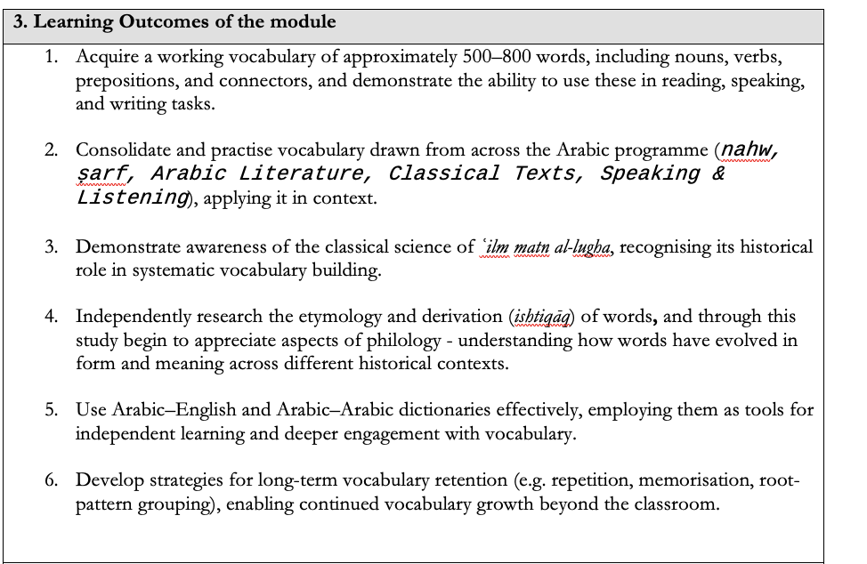
Vocabulary Support

Slide 73
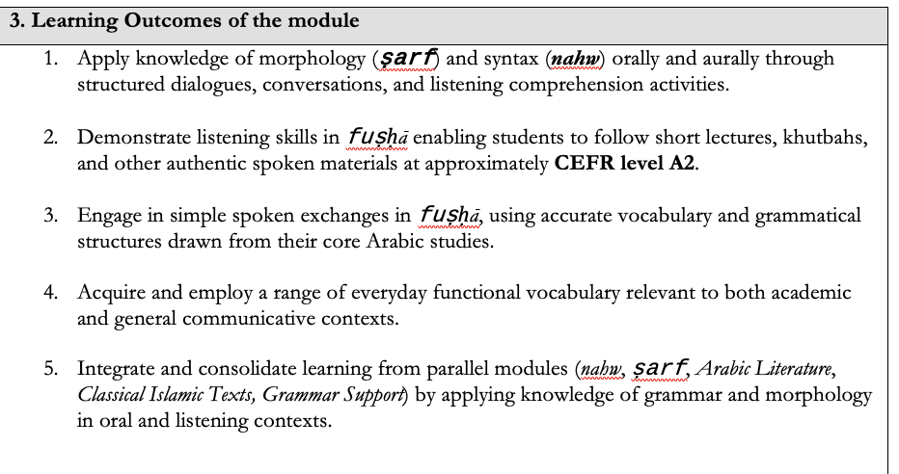
Speaking & Listening

Slide 74
Q&A

